Slide 1


Team Name: Team A3
Cognizant NPN AI HACKATHON
PRICE PLAN RECOMMENDATION
Team Members
Member Name | Role
KHUSHI THAKUR | UI development(FRONTEND)
KOMMU SONY | Database
KUKKALA RAHUL | Backend
KONERU SARVANI | Machine Learning
K.UMA MAHESWARI | EDA &Machine Learning
MASHAM SANJAY | Integration
MITTAPELLY ARCHITHA | PowerBI
COGNIZANT MENTOR:
Katari Rajesh
MREC MENTOR:
K V Vara Prasad

Slide 2
Problem statement Price plan Recommendation
The problem focuses on recommending suitable tariff plans to customers based on their individual usage patterns. Existing publicly available tariff plans from operators can be used as references to design new, customized plans. The total number of tariff plans should not exceed 25 to maintain simplicity and clarity. Finally, each customer must be provided with the top 3 most relevant tariff plan options derived from their usage data.
Tasks:
Develop a recommendation system for telecom tariff plans.
Analyze diverse customer usage patterns and segment them effectively.
Build ML models (KNN + LightGBM) for accurate plan recommendations.
Ensure recommendations are explainable and scalable for thousands of users.
Challenges:
Data Diversity: Highly varied usage patterns complicating clustering and classification.
Class Imbalance: Certain plans chosen more frequently than others, skewing the dataset.
Feature Leakage Risk: Raw attributes inflated accuracy; required feature selection and noise control.
Scalability: Efficient system design needed to handle thousands of customers and multiple plans.
Interpretability: Recommendations must be understandable to build customer trust.

Slide 3

Abstract
Telecom users often face information overload, complex pricing structures, and lack of personalization when choosing plans. As a result, many customers end up with unsuitable plans—either overpaying or encountering hidden costs.
TariffGenie addresses this challenge through an AI-driven platform that:
Learns from user history and preferences
Utilizes machine learning and data analysis
Provides personalized top plan recommendations
Keywords:Telecom,powerBi,Machine Learning,Top plan suggestions
Final presentations
2
© 2024 Cognizant

Slide 4
INTRODUCTION
.no Use Case Data Source Use case D
Mobile telecommunication has become an essential part of modern life, with providers offering a vast range of tariff plans. While this variety gives consumers more choices, it also creates confusion in selecting the most suitable and cost-effective plan. Many users either overpay for unused services or face unexpected costs due to insufficient allowances.
The challenge arises from information overload, lack of transparency, dynamic usage patterns, and absence of personalization. Current comparison methods are either too generic or fail to adapt to individual customer needs.
TariffGenie addresses this gap through an AI-powered recommendation system that leverages machine learning, data analysis, and user history to deliver personalized tariff plan suggestions. It helps users simplify choices, optimize expenses, and enhance their mobile experience.

Slide 5
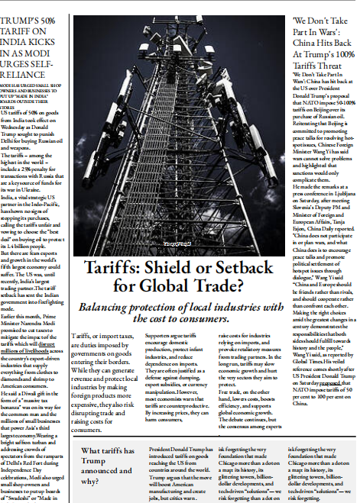
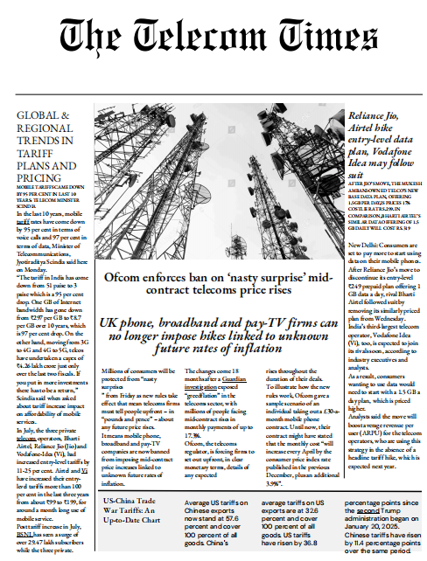
Literature survey

Slide 6
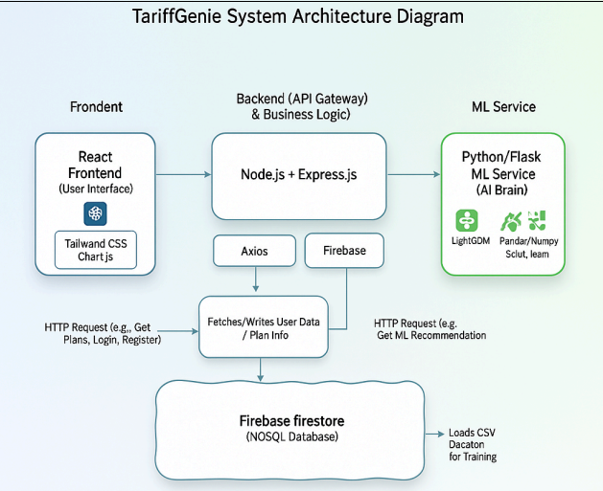
SYSTEM ARCHITECTURE
© 2023 Cognizant

Slide 7
METHODOLOGY
The project follows a data-driven approach, beginning with the collection of customer history and preference data. This data undergoes preprocessing techniques such as cleaning, normalization, and feature engineering to ensure high-quality inputs.
Next, K-Means clustering is applied to group users with similar usage patterns. This segmentation enables the design of customized tariff plans that are more relevant and cost-effective.
To provide accurate recommendations, a LightGBM model is trained on the processed datasets. This hybrid approach ensures that each user receives the top three most suitable plans, balancing accuracy with personalization.
Finally, the trained ML models are integrated into a full-stack web application. This system offers real-time plan recommendations, comparison dashboards, and interactive user interfaces, along with advanced features such as a data marketplace and network analysis. These features not only enhance customer experience but also support telecom providers in retention, revenue growth, and transparency.
1
© 2025 Cognizant

Slide 8
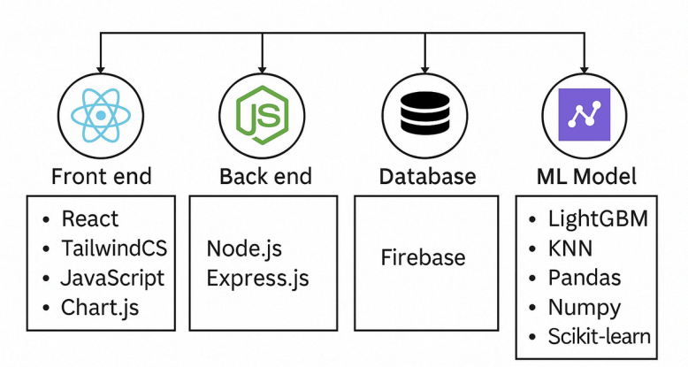
TECHNOLOGY STACK
5
© 2024 Cognizant

Slide 9
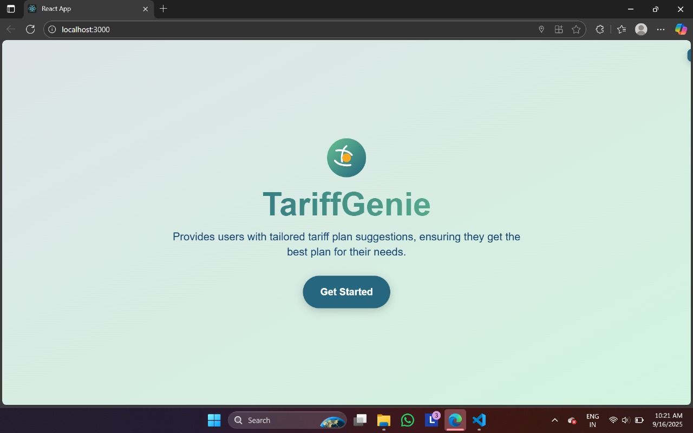
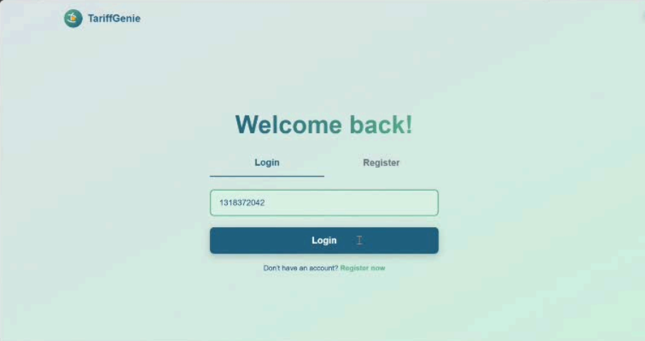
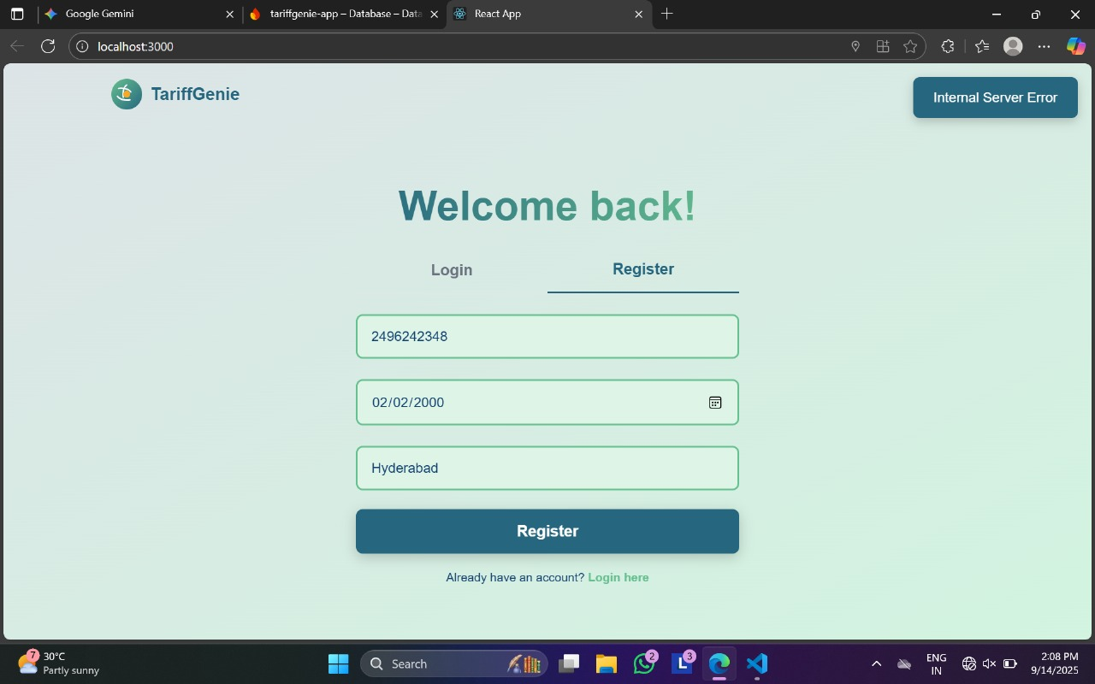
User Interface
11
© 2025 Cognizant

Slide 10
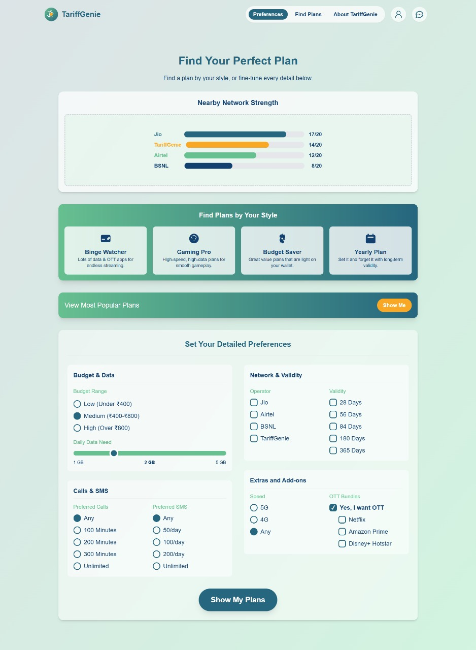
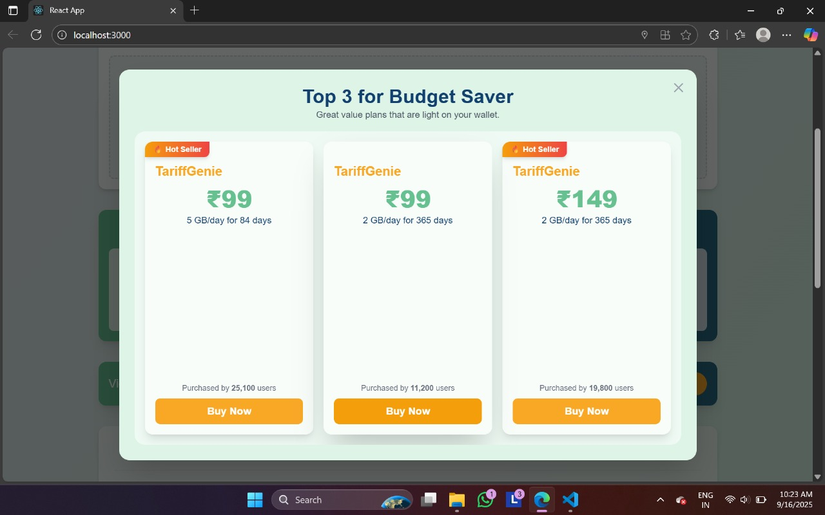

Slide 11
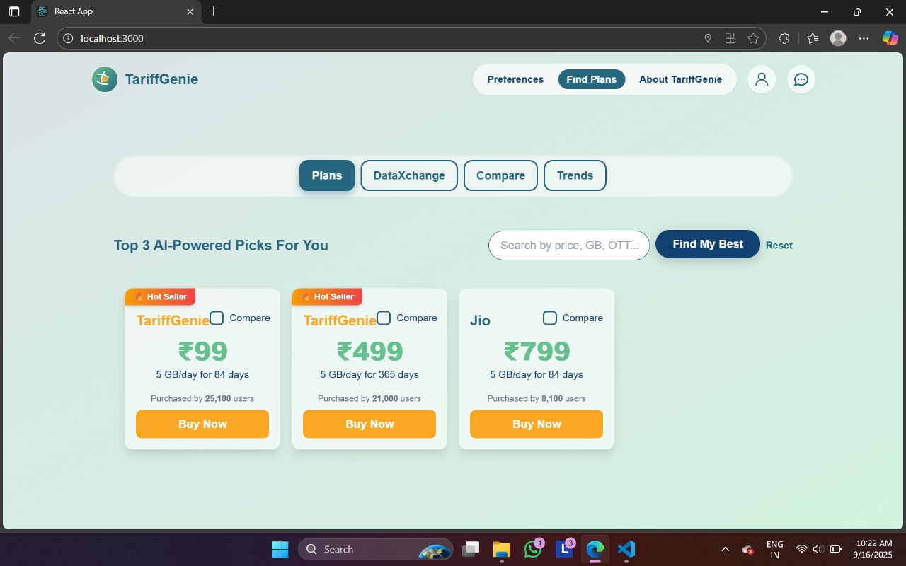
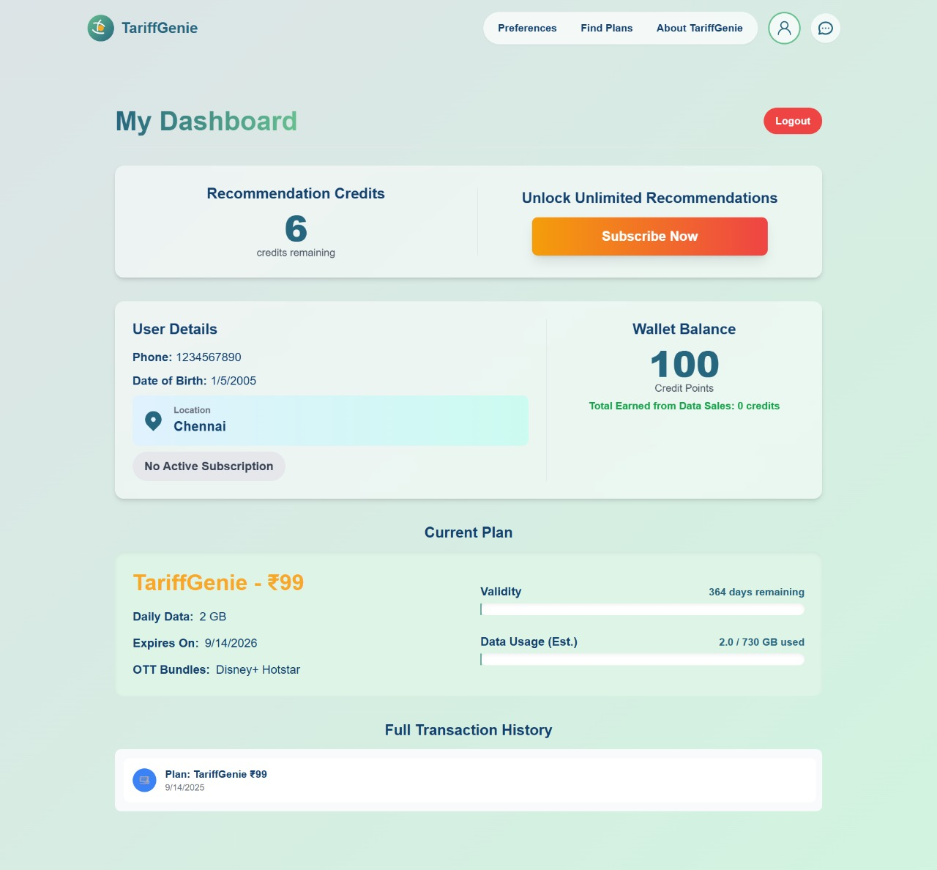

Slide 12
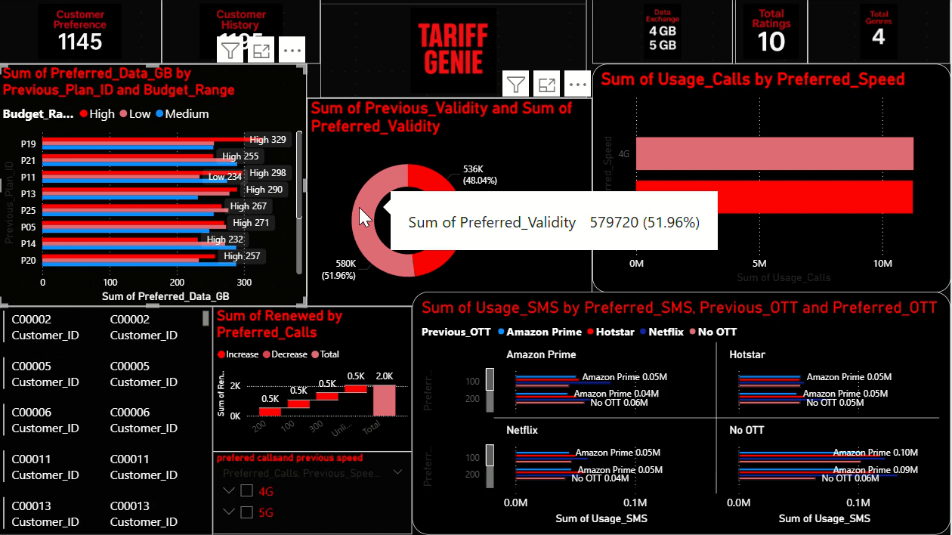
PowerBi

Slide 13
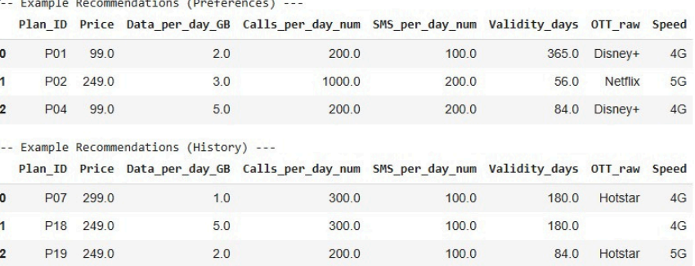
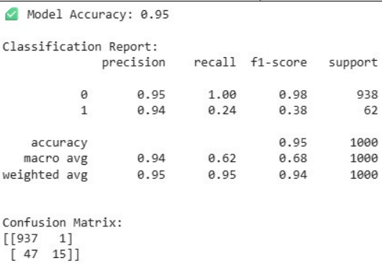
RESULT

Slide 14
Conclusion
The TariffGenie project has proven to be a comprehensive solution to one of the major challenges in the telecommunications sector—personalized tariff plan recommendations. By leveraging machine learning with a 95% accuracy rate, the system ensures that users receive highly reliable and relevant suggestions tailored to their usage behavior. A curated set of 25 optimized plans was derived from the raw datasets, ensuring that customers are not overwhelmed with too many choices but still receive diverse options. The project also demonstrates a complete and modern architecture by integrating a React frontend for seamless user interaction, a Node.js backend for robust handling of requests, and a Python-based ML microservice to deliver intelligent recommendations. Distinctive features like the DataXchange marketplace, which allows sharing and exchanging data, and real-time network strength analysis, which provides location-based insights, give TariffGenie a clear edge over simple comparison tools. It not only empowers customers to make informed decisions but also highlights opportunities for telecom operators to improve customer satisfaction and retention. Overall, the project stands as a strong proof-of-concept that combines innovation, scalability, and user-centric design, laying the groundwork for a commercially viable and impactful telecom service management platform.

Slide 15
Future Scope
While TariffGenie has achieved its primary objectives, several improvements can make the platform more advanced and industry-ready. The first is automated data ingestion, where direct integrations with telecom operator APIs will ensure that tariff plans and offers are updated in real time without manual intervention. Secondly, enabling historical usage analysis through bill uploads or operator account linkage will allow the system to consider actual past behavior, leading to even more accurate recommendations. Another important enhancement is subscription and payment integration, where platforms like Stripe, PayPal, or Razorpay can be embedded to facilitate smooth transactions for plan purchases and DataXchange activities. To maintain the accuracy and relevance of predictions, a CI/CD-based ML retraining pipeline should be implemented, ensuring that the model evolves continuously with new customer data. The expansion of the platform into a mobile application for iOS and Android will provide users with convenient, on-the-go access to services. Additionally, features like personalized notifications, chatbot assistance, multilingual support, and predictive analytics for future usage trends can further enhance the user experience.

Slide 16
Thank You
14 © 2025 Cognizant |

